Slide 1

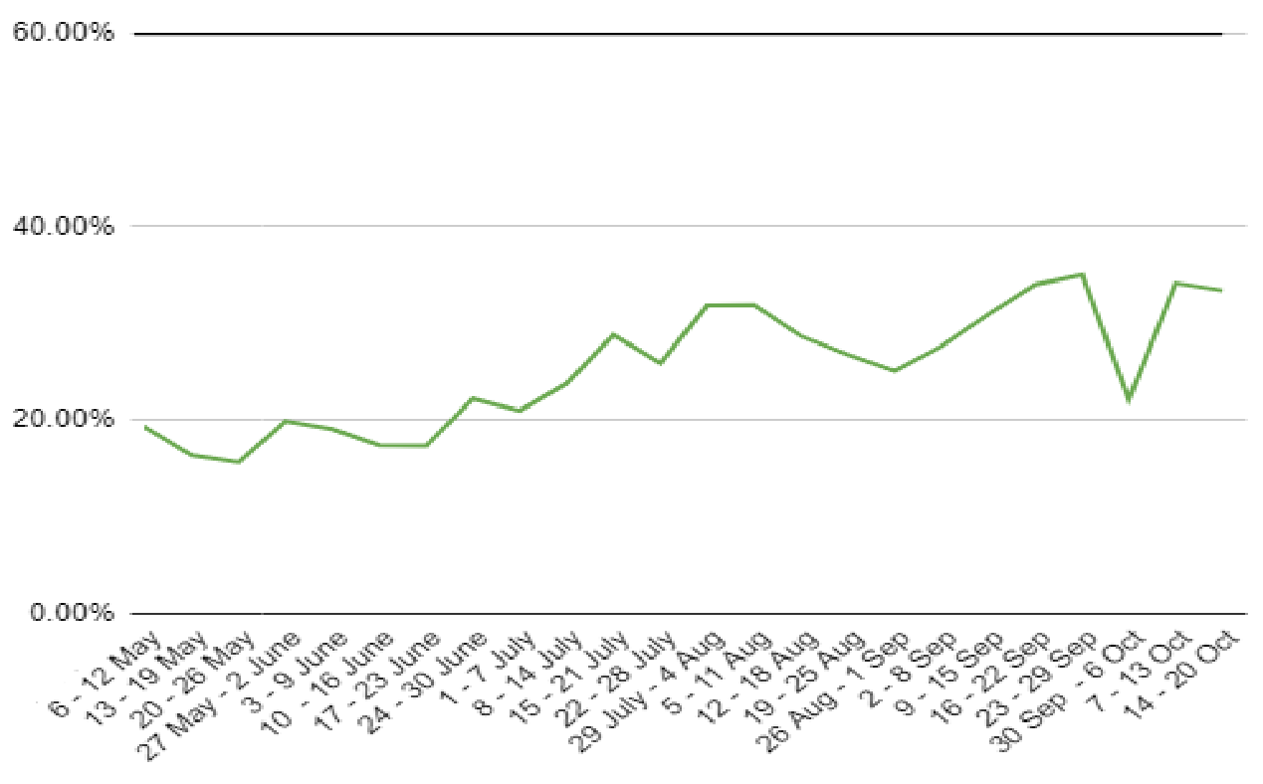
Online application conversion
Commercial Context
With existing budget and volumes increasing to 60% conversion could bring in an additional 4,500 new customers annually.
Market Context
This conversion number is broadly between 50% and 70% for low and medium risk products (eg deposit and tran accounts).
Customer context
Joining the bank and the experience underpinning is a ‘core CX moment of truth’ that can ‘validate’ a customer intent to switch and help set up customer for a sustainable relationship.
Online application conversion rates, measured to submitted application
See appendix ‘Data Sources’

Slide 2
Online application conversion
All online deposit accounts, new customers
39% start to submitted application. 23% start to account open.
26,802
Application starts
Personal details
Check your details
ID details
Application submitted
Account open
Account activated
100%
1,890
47%
888
43%
813
42%
739
39%
736
23%
439
4%
80
Product
visits
New + existing
Intent
(53%* lost)
Middle funnel
(17%* lost)
Account opening
(40%* lost)
Activation
(82%* lost)
*% lost is relative between the stages. See appendix ‘Data Sources’

Slide 3
Our 5 step approach to reaching 60%+ online conversion
Refine conversion roadmap
We operate on a rolling 3 month schedule. Initiatives prioritised from conversion backlog based on expected CVR impact - BRS documents delivered, development quotes completed and implementation dates confirmed.
Implement monthly releases
Getting the improvements in - deployments to TJM released as per a monthly cadence.
Optimise processes
Getting under the hood – review and refine internal processes, including connected third-party services (Ops, Biocatch, Equifax)
Optimise quality & prequalified traffic
Target the right audience - ongoing optimisation of quality traffic, ensuring an appropriate balance of volume and conversion (including CVP)
Improve reporting
Better insights - continuous improvement of funnel tracking, moving from current state (many gaps) to desired state (end to end tracking) – exposing opportunities that identify new and drive prioritisation of initiatives. Proposal to plug most of these gaps will be provided in November.
(1)
Refine 3 month rolling conversion roadmap
(5)
Improve reporting
(2)
Implement monthly TJM releases from roadmap
(4)
Optimise quality & prequalified traffic
(3)
Optimise processes
+
+ + = 60%
Quality traffic with intent
Great UX
Improved ID & fraud processes
23%
Current start to account open
+25% uplift
Conversion
+4% uplift
+8% uplift

Slide 4
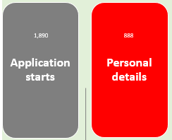
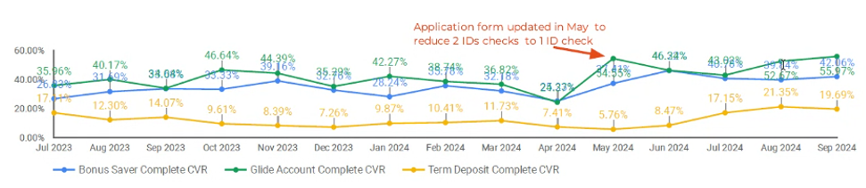


Intent
(53% lost)
Opportunity: 53% of starts drop off early in the process
CONTEXT:
The quality and intent of traffic, brand and product propositions all impact on our conversion rates.
Organic search traffic has the highest conversion rates due to familiarity with the brand and visiting with intent – in Sep organic search traffic to Glide converted at 56% (to submitted application). Whereas TD generic paid search has been as low as 2%.
What are we doing about it?
Paid search is being optimised to the 60% conversion targets with strong progress – brand related ad groups are performing above 50% with optimisations continuing on generic keywords campaigns
Pre-qualification screens recently added to the website, with analysis on the impact of conversion rates underway to determine a potential tweak in the measurement framework
CVP & segmentation work is progressing and will tighten our targeting & messaging to potential customers.
Online application conversion rates from organic search traffic,
measured to submitted application
*% lost is relative between each stage.

Slide 5
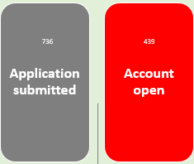

Account opening
(40%* lost)
Opportunity: 40% of submitted apps don’t result in an open account
CONTEXT:
The two biggest contributors to the drop out here are:
22% of customers fail the online ID process
15% of customers receive a 1,000+ Biocatch score and are rejected
We also still have an issue with new to bank joint bonus saver accounts that fail to open through straight through processing.
What are we doing about it?
Investigating alternative paths for those that fail ID –(e.g. Digital ID)
Current deep dive into Biocatch and related processes
New to bank joint bonus saver account fix to be implemented in
Adding more granular tracking of ID and other failure reasons (linking back to traffic driving sources)
Longer term strategic view – monitoring uptake of new national digital ID solutions (to get on board when adoption rate is approaching tipping point)
*% lost is relative between each stage.

Slide 6
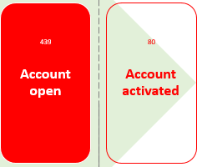

Activation
(82%* lost)
Opportunity: Only 18% of opened accounts are activated
CONTEXT:
With only 18% of opened accounts being activated this leaves an opportunity to activate the remaining 82%.
41% of new to bank customer accounts are marked as suspected fraud (with accounts in limbo, customers unable to transfer in or out), meaning half our opportunity is taken away
No real-time notification to NPP of the new accounts - customers attempting to transfer funds in immediately will fail
What are we doing about it?
Current deep dive into Biocatch and related processes, with recommendations to follow in November
NPP real-time currently scheduled for April 2025
Refer to on-boarding journey for full details
*% lost is relative between each stage.

Slide 7
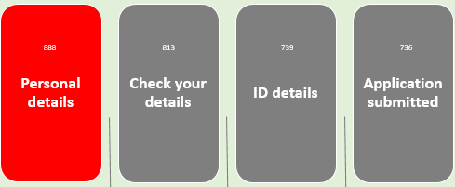
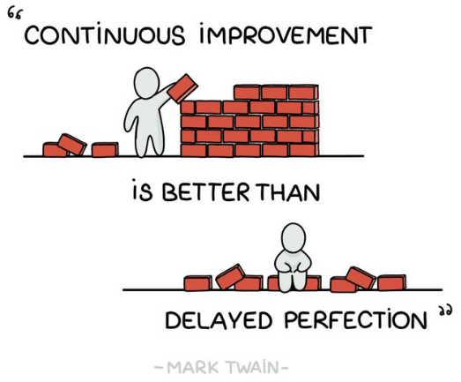
Middle funnel
(17%* lost)
Opportunity: 17% of those that continue past start fail to submit
% lost, relative to each stage:
CONTEXT:
The data indicates that once consumers have committed and progressed through the application there is relatively smaller drop off to submitting the application.
The highest loss in this part of the funnel is on the ID details section. Most users abandoning are interacting at 96%, with 6% leaving with no form field interaction. Of those that interacted the driver’s licence card number was the top abandonment field at 42%, followed by 13% on passport country of issue.
The second highest loss in this part of the funnel is on personal details, which may also be related to lack of willingness to commit. 29% are leaving without any form interaction. Of those that do interact the address field is highest at 24%, with everything else fairly evenly spread.
What are we doing about it?
We are rolling out monthly TJM releases containing UX and process improvements, prioritised based on drop-off and interaction insights – with a particular focus on the ID section.
Personal details
TFN
Source of income
Check your details
ID details
Submit
7% lost
0.2% lost
2% lost
1% lost
10% lost
*% lost is relative between personal details and submit.

